Slide 1
Test Validation Topics in the BILC Testing Seminars
Peggy Garza
Associate BILC Secretary

Slide 2
Language Testing Seminar (LTS)
Began in 2000
Traditional approach to test validation

Slide 3
Language Testing Seminar (LTS)
2000-2008
Two phases of test validation
Preliminary quality control
Review items (texts and tasks)
Administer to native speakers
Pretest with groups with known proficiency levels
Formal validation
Concurrent validity: statistical correlation with another validated STANAG 6001 test

Slide 4
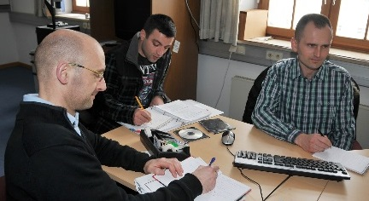
Language Testing Seminar (LTS)
2000-2008
Concepts
Validity, reliability, practicality
Practical activities
Item analysis
Facility value
Discrimination index
Distractor efficiency

Slide 5
Language Testing Seminar (LTS)
2000-2008
Reference materials
The Concepts of Reliability and Validity in Military Training and Education by CDR Andre Gervais, Canadian Forces Language School
Testing for Language Teachers by Arthur Hughes, Chapter 4, Validity and Chapter 5, Reliability
Appendix 1, Statistical Analysis of Test Data

Slide 6
Language Testing Seminar (LTS)
2009-2016
Updates influenced by
Benchmark Advisory Test (BAT) project
Advanced Language Testing Seminar (ALTS)

Slide 7
Benchmark Advisory Test (BAT)
2005-2009
To promote consistent interpretation of STANAG 6001 across national testing programs.
To provide an external measure against which nations can compare their national STANAG 6001 test results.
To pursue a joint development project as a way of demonstrating how STANAG 6001 tests can be designed, developed and scored.

Slide 8
Benchmark Advisory Test (BAT)
New testing seminar topics resulting from the BAT project
Criterion-referenced (CR) proficiency testing
Criterion-referenced (CR) scoring
Standard setting using modified Angoff
Random/ Emerging/Developing /Sustained (REDS)
Item Response Theory (IRT) analyses

Slide 9
Dr Ray Clifford, 2016 BILC Conference in Riga, Latvia
If they align – everything’s fine
Construct Definition ☺
Test Design & ☺ Development
Test Scoring ☺

Slide 10
Advanced Language Testing Seminar (ALTS)
Began in 2009
Three-day module on test validation practices

Slide 11
Advanced Language Testing Seminar (ALTS)
2009-2012
Module 3, Test Analysis
Quantitative analysis methods
Introduction to statistical tools- Excel and SPSS
Interpretation of results
Qualitative analysis methods
Questionnaire design
Additional qualitative analysis methods
Standard setting
Angoff and contrasting groups method
Exercises on standard setting using Angoff
Contrasting groups method

Slide 12
Advanced Language Testing Seminar (ALTS)
2012-2016
Module 3, Test Validation
Revision of Basic Terms in Test Analysis
Quantitative Analysis Methods
Introduction to statistical tools -Excel and SPSS
Interpretation of results
Preparation of alternate test forms
Challenges of piloting test items
Qualitative Analysis
Questionnaire design
Additional qualitative analysis methods
Standard setting
Exercises on standard setting using the Angoff method
Validity Argument

Slide 13
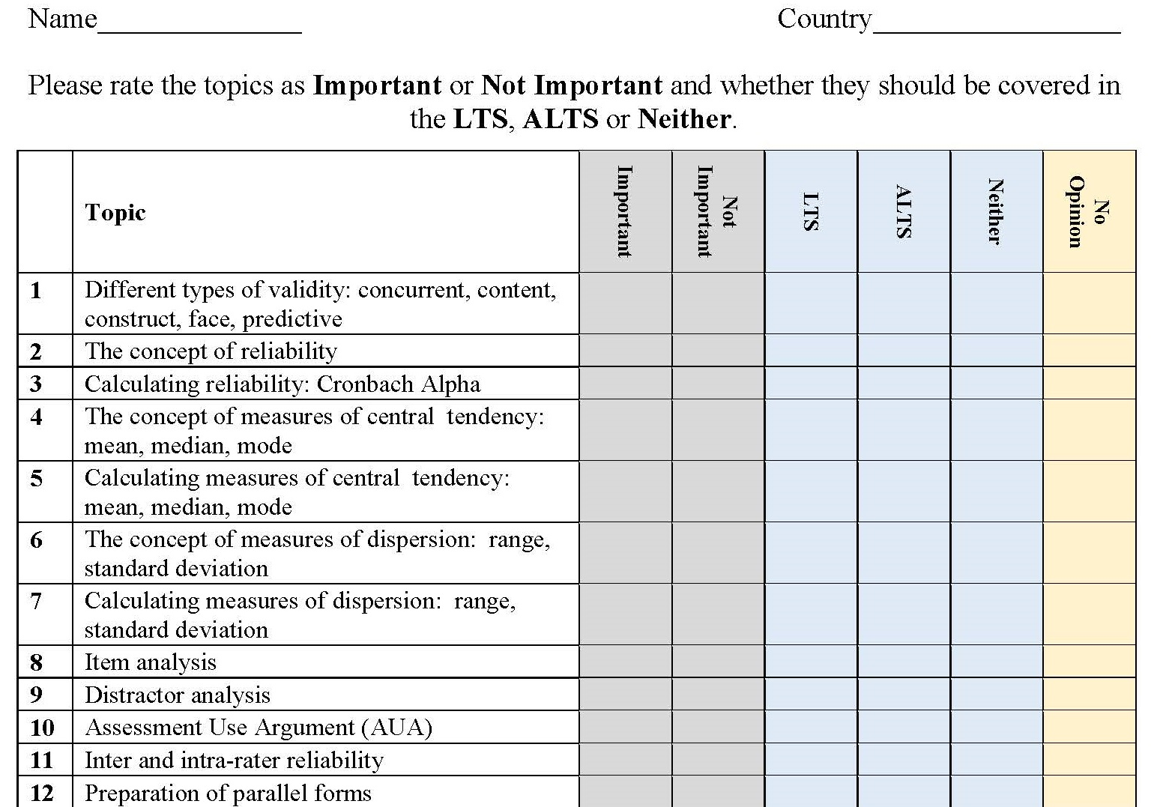
Submit your input by this afternoon

